Slide 1

Analysis of Cybersecurity Breach Involving a Software Vulnerability: RSA
Gregory Mamoyac
Cyber 204 Software Security
Professor Jennia Hizvver
Notes:
presentation is on the cybersecurity breach surrounding RSA

Slide 2
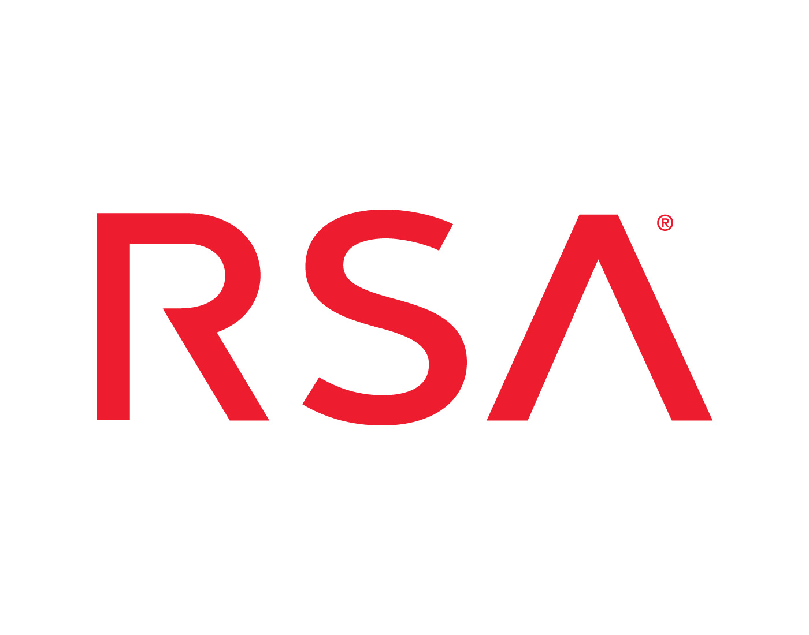
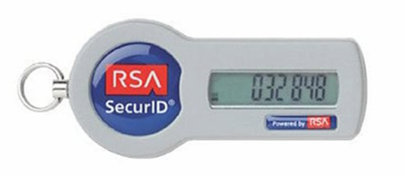
Background of RSA
Company was founded by Ron Rivest, Adi Shamir, and Leonard Adleman.
Found the RSA public key cryptography algorithm.
Offer cybersecurity and digital risk management solutions, as well as authentication and access capabilities for cloud, hybrid, and on-premises environments.
Clients included defense contractors like Northrop Grumman and Lockheed Martin.
Notes:
RSA was founded by Ron Rivest, Adi Shamir, and Leonard Adleman
The company found the RSA public key cryptography algorithm and are most famous for the SecureID token fobs that generate pins for 2 factor authentication
RSA also offers cybersecurity and digital risk management solutions as well as authentication services like the SecureID tokens for all work environment types
Clients include government contractors and defense contractors like Northrup Grumman and Lockheed Martin

Slide 3
Summary of Breach
In March 2011, RSA was infiltrated through spear phishing employee emails.
Poison Ivy payload was planted via a zero-day Adobe Flash vulnerability that took advantage of .swf file embedded in Excel for privileged access and backdoor for continuous entry.
It was concluded that the Chinese Army aka APT-1 exfiltrated the company’s root authority to access the secret seeds from the root server.
Notes:
In March 2011, engineers at RSA noticed that accounts were being logged into from unassociated workstation IPs and then determined that they were infiltrated and linked the breach to an email account in Australia.
They discovered the Poison Ivy payload that was planted via Adobe Flash content embedded in the swift file of an Excel spreadsheet, enabling privileged escalation and continuous access through backdoor.
It was concluded that the Chinese Army aka APT-1 infiltrated the company’s root authority to access the secret seeds from the root servers in their network.
These secret seeds were used in the creation of all pins used in the SecureID tokens

Slide 4
Description of the Attack
Phishing
Attackers orchestrated spear phishing with payload hidden in Excel doc.
Privilege Escalation
Attackers were able to escalate vertically to more privileged accounts.
They used credential stealing hopscotch tool to pull usernames and passwords to log into other machines.
Supply Chain Failure
Windows was not patched and allowed the payload to slip security within the Excel doc.
The root server was not air gapped because was it used for manufacturing and for setting up local root servers and key escrow every 15 minutes.
Notes:
The Description of the Attack consists of an overview of the methods the attackers used against RSA.
The first attack vector was Phishing. And this allowed for the attackers’ entry point. After the employee was properly deceived, the attackers executed a hidden payload and in this case, within a excel spreadsheet entitled “2011 Recruitment Plan”.
Once inside the network, they were able to escalate vertically to more and more privileged accounts until they found an admin user account with hundreds of usernames and passwords.
To do this they used a credential-stealing hopscotch tool that pulled the sensitive information and reused it to log into the other machines.
The major damage of the attack, however, came from the supply chain failure of an unpatched workstation used for manufacturing in Australia.
Also, this led to the escalation of the root servers that stored seeds for the SecureID pins. These root server operated for manufacturing secureID tokens and cds that’s were distributed to customers.
While security best practices rule that these types of servers should be airgapped and disconnected from the network entirely, they were accessed regularly during manufacturing.
However, the regular 15 minutes manufacturing intervals became thousands of continuous requests for data every second during the breach.

Slide 5

Description of the Attack
Security advisory for adobe flash: CVE-2011-0609
CVSS Base Score: 7.8 High
Description: Zero-Day exploit allows remote attackers to execute arbitrary code or cause a denial of service (application crash) via crafted Flash content demonstrated by a .swf file embedded in Excel
Notes:
The breach was ultimately exploited through the zero day vulnerability, enumerated in Security Advisory for Adobe Flash CVE-2011-0609
NIST rated the exploit with a CVSS base score of 7.8 High
And describes that it allowed remote attackers to execute arbitrary code or cause a Denial of Service via the flash content and backdoor embedded in Excel

Slide 6
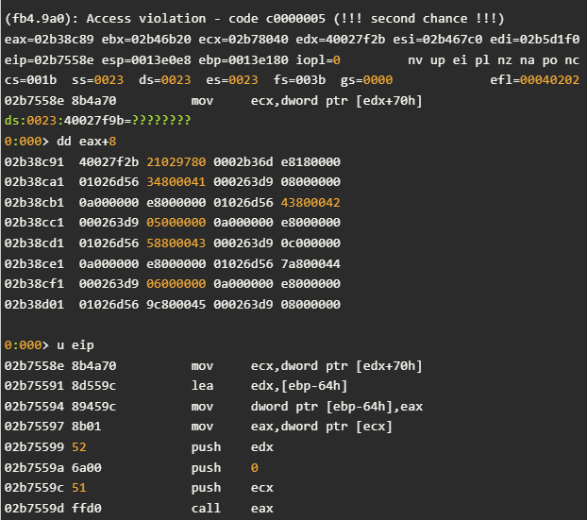
Description of the Attack
Vulnerability
A one-byte alteration (fuzzing) occurs via well-formed bytecode stream against .swf file
Memory Execution
The bytecode bypasses the verification process and the native code is generated and placed in VirtualAlloc()'d executable memory.
Security Implication
The results of this code references uninitialized memory that is vulnerable to heapspraying and eventually arbitrary code execution.
Notes:
The description of the attack is shown through proof of concept. This is a decompiler output of a swift file like the one found in the RSA breach.
The attacker begins by using one-byte alteration or fuzzing to cause an Access Violation that displays the register for EAX and other registers of the swift file.
The fuzzing is done through random data input consisting of well-formed bytecode streams or “NOP sled” to expose adjacent memory.
Once the bytecode stream passes the program’s verification process, native code is generated and placed in VirtualAlloc()'d executable memory.
The results of the execution reveal uninitialized memory spaces that the attacker can take advantage of through heapspraying and eventually arbitrary code execution
The uninitialized memory is denoted by the green question marks at the location ending 27F9B
During this exploit, more reconnaissance can be seen near the EAX register and adjacent memory locations displayed by the EIP instruction pointer showing where the program crashed
You can also see the memory violation beginning around the MOV ECX memory allocation space.

Slide 7
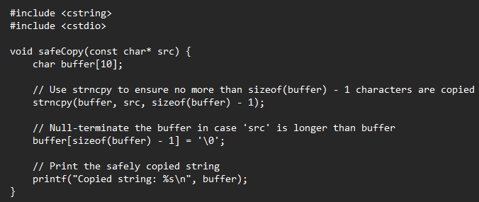

Remediation Steps
Improper Restriction of Operations within the Bounds of a Memory Buffer: cwe-119
Known as Buffer Overflow
Description: When operations are performed on a memory buffer, but it executes to a memory location outside the buffer's intended boundary. This result in read or write operations on unexpected memory locations that could be linked to other variables, data structures, or internal program data.
Remediation: Ensure buffer operations are within defined limits, often using safer functions like strncpy.
VULNERABLE CODE
REMEDIATION
Notes:
To avoid the exploitation of memory allocation and code execution in the last slide, Remediation Steps include addressing the weaknesses found in the low level code
First, for CWE-119. Buffer Overflow occurs where a program does not properly check bounds when accessing memory, leading to overflows that can execute in unexpected memory locations.
The remediation for this is to ensure buffer operations are within defined limits, often using safer functions like strncpy instead of basic strcopy and then guaranteeing that the string is null-terminated if the buffer is overrun.

Slide 8
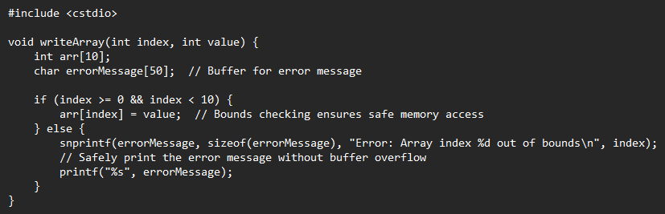

Remediation Steps
Out-Of-Bounds Write: cWE-787
Known as Memory Corruption
Description: Often used to describe the consequences of writing to memory outside the bounds of a buffer, or to memory that is otherwise invalid.
Remediation: Check array bounds before writing data and proper error handling.
VULNERABLE CODE
REMEDIATION
Notes:
Next, CWE-787: Out-of-bounds Write, also known as Memory Corruption describes the consequences of writing to memory outside the boundaries of allocated memory buffers, allowing an attacker to overwrite the memory associated with other objects or control structures.
To remediate this weakness, its important ensure that code includes limits such as index less than 10. Also error handling like snprintf ensures truncation and prevents buffer overflow if the error message is larger than the buffer size

Slide 9



Remediation Steps
Social Engineering Training
Supply Chain Validation
Network Segmentation and Air Gapping
Notes:
Following the 2011 RSA data breach of Secure ID tokens, there were additional remediation steps RSA could have taken to further mitigate the breach.
First, enhancing social engineering training could have been crucial in preventing the initial spear-phishing attack that led to the systems' infection. Promoting stronger awareness and response to phishing tactics across the organization would have been a valuable defense.
Additionally, rigorous supply chain validation could have helped reinforce security at the physical level. By enforcing proper network segmentation and air-gapping root servers on the manufacturing side, RSA would have created critical layers of separation, reducing the risk of such a breach."

Slide 10
Impact and Legal Actions
RSA continued defense that other attacks were not directly related to their breach.
Media cover on attacks for Google, Sony, and the Australian government increased customer sensitivity to risk.
RSA spent a total $66 million on the business continuity and disaster recovery efforts following the breach.
Notes:
In the aftermath of the security breach, RSA continued to defend its position, asserting that other subsequent attacks weren’t directly tied to their own security incident.
However, the media coverage surrounding high-profile breaches involving companies like Google, Sony, and even the Australian government heightened public opinion to potential risks.
In response to this increased awareness and concern, RSA invested heavily in ensuring business continuity and resilience. Their recovery efforts ultimately totaled $66 million, demonstrating a serious commitment to restoring trust and reinforcing their security framework.

Slide 11
Impact and Legal Actions (Continued)
Public Disclosure and customer notifications for adding and lengthening SecureID PINs.
Defense Contractors, Incident Response, NSA, and FBI called to help the investigation.
Congressional briefing to Senate Armed Services Committee.
Impacted the attack surface major government contractors
Companies like Lockheed Martin claimed that they have prevented an attempted breach of sensitive or classified data in June 2011.
After 10-year NDA, RSA revealed that attackers never stole the full list of seed values, nor the customer list mapped to those seed.
Notes:
Following the breach in 2011, RSA formed a 90-person task force to directly contact customers and stakeholders. This included protective measures for adding and lengthening secureID pins
Defense contractors like Lockheed Martin, and Northrup Grumman as well as Incident Response companies like Mandiant and federal agencies were also called to help the investigation.
RSA was also called to a congressional briefing for the Senate Armed Services Committee where the company was linked to “Atleast one defense contractor falling victim to the breach and having to replace all secureID tokens.”
Lockheed Martin later announced an attempted breach of data that they prevented- and claimed the attempt was caused by SecureID tokens.
However, after the legal NDA that lasted 10 years, RSA revealed that the attackers never stole the full list of seed values, nor the customer list mapped to those seeds that was needed for exploitation.
In conclusion, the analysis of RSA’s Breach highlights the complex interplay between technological innovation and security, emphasizing the need for ongoing vigilance, proactive measures, and collaborative efforts to safeguard data against evolving threats in cybersecurity.

Slide 12
Work Cited
G. Cohen, “Throwback Attack: RSA SecurID attack shows the importance of protecting critical assets,” Industrial Cybersecurity Pulse, Feb. 23, 2023. https://www.industrialcybersecuritypulse.com/threats-vulnerabilities/throwback-attack-rsa-securid-attack-shows-the-importance-of-protecting-critical-assets/
A. Greenberg, “The Full Story of the Stunning RSA Hack Can Finally Be Told,” Wired, May 20, 2021. https://www.wired.com/story/the-full-story-of-the-stunning-rsa-hack-can-finally-be-told/
“RSA hackers exploited Adobe Flash vulnerability,” Infosecurity Magazine, Apr. 04, 2011. https://www.infosecurity-magazine.com/news/rsa-hackers-exploited-adobe-flash-vulnerability/ (accessed Nov. 01, 2024).
“CWE - CWE-119: Improper Restriction of Operations within the Bounds of a Memory Buffer (4.0),” cwe.mitre.org. https://cwe.mitre.org/data/definitions/119.html
“CWE - CWE-787: Out-of-bounds Write (4.2),” cwe.mitre.org. https://cwe.mitre.org/data/definitions/787.html

